Slide 1
Neural Networks and PyTorch
Lecture 14
Introduction to neural networks and PyTorch

Slide 2



Do not edit How to change the design
Join at slido.com #1935834
The Slido app must be installed on every computer you’re presenting from

Slide 3
Limitations of Fixed Basis Functions

Slide 4
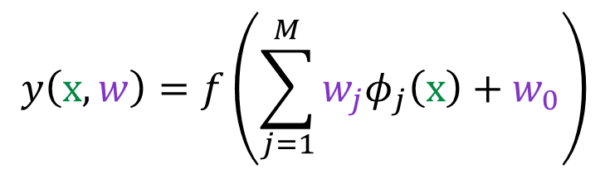
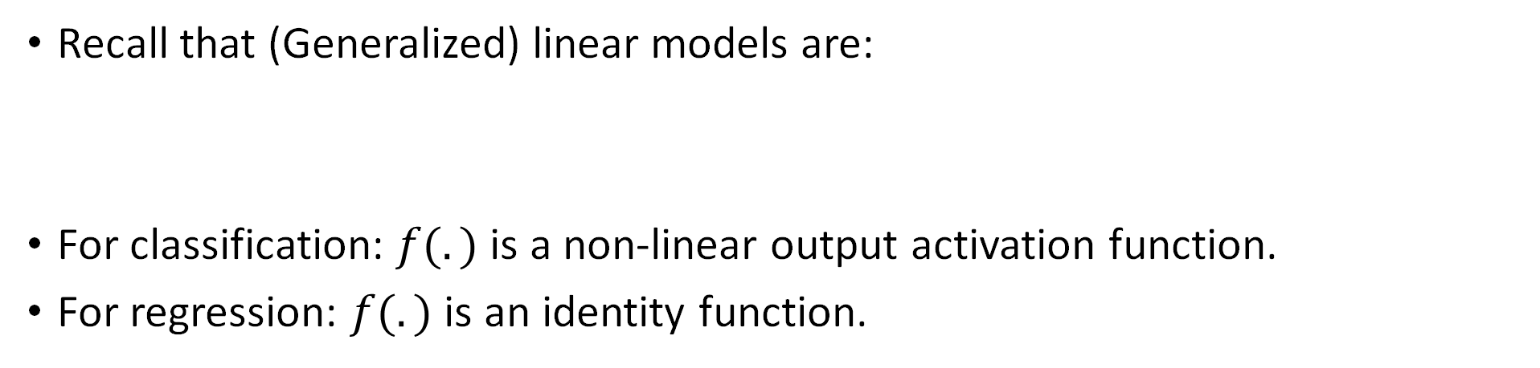
Linear Models
Recall that (Generalized) linear models are:
For classification: $f(.)$ is a non-linear output activation function.
For regression: $f(.)$ is an identity function.
$$y\left(x, w\right)=f\left(\sum_{j=1}^{M}{w_{j}φ_{j}\left(x\right)+w_{0}}\right)$$
Can we approximate any function with sufficient accuracy if the set of $φ_{j}\left(x\right)$ is rich enough?
In most cases NO, because $φ_{j}\left(x\right)$ are fixed and independent of the training data.

Slide 5
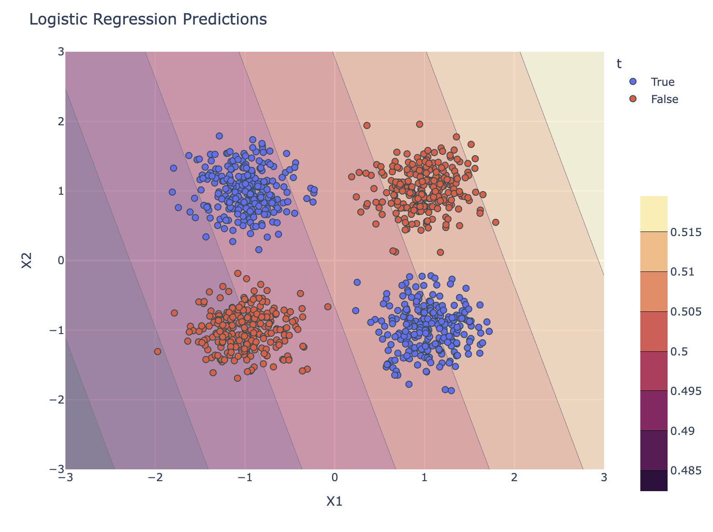
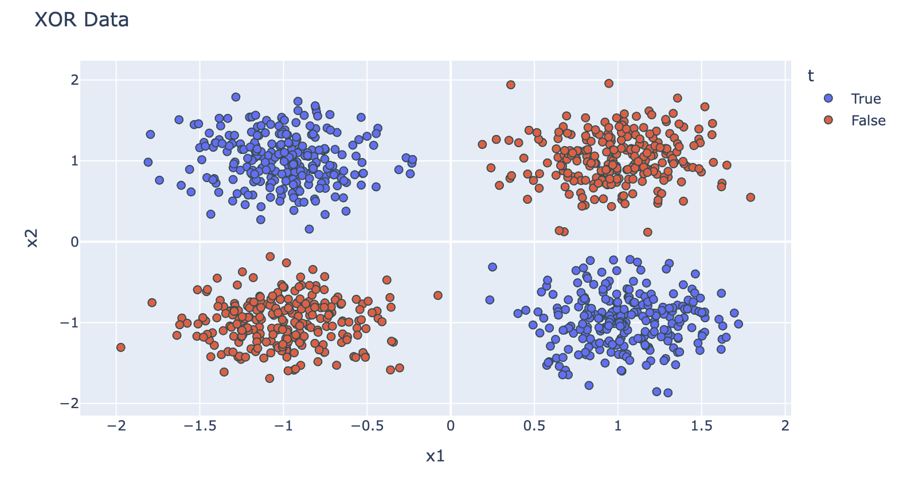
Demo
The XOR Problem

Slide 6
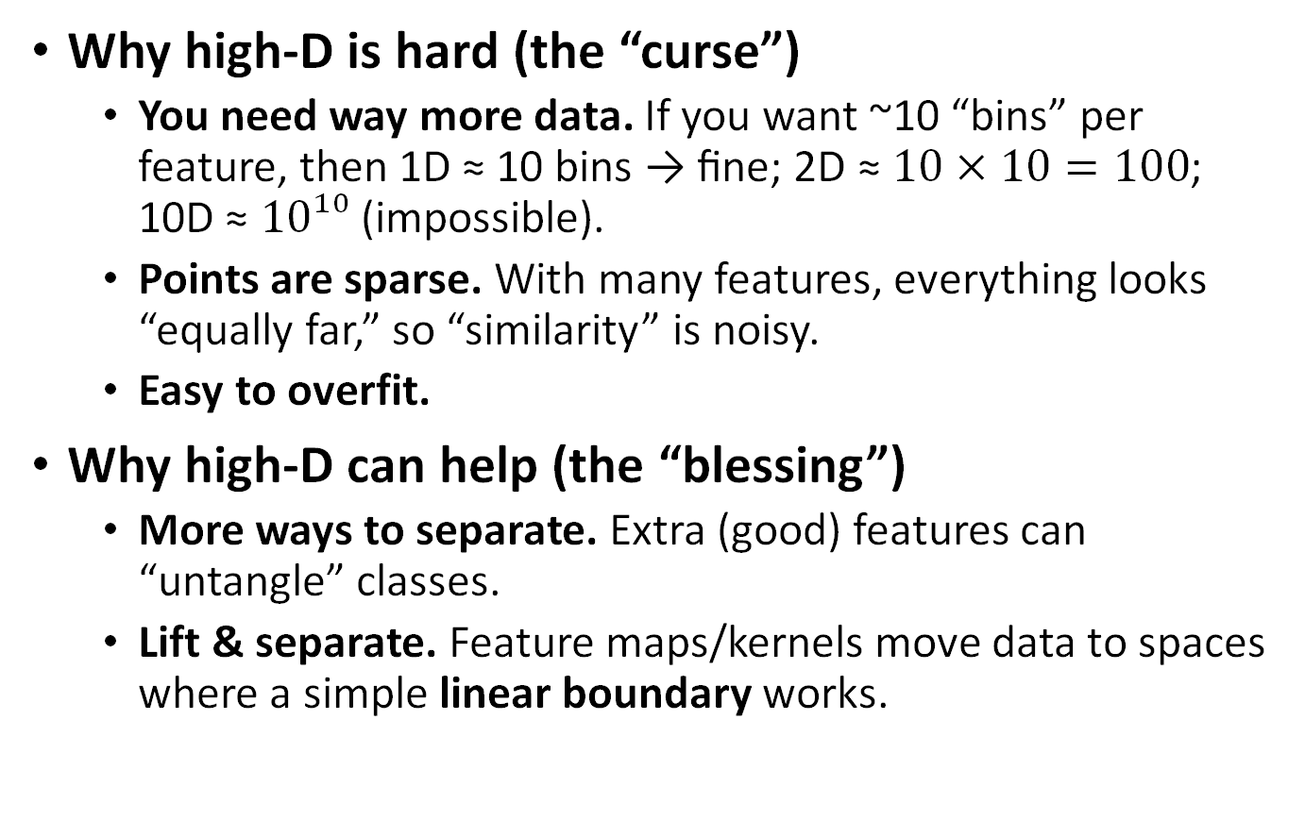
High Dimension: Curse & (Surprising) Blessing
Why high-D is hard (the “curse”)
You need way more data. If you want ~10 “bins” per feature, then 1D ≈ 10 bins → fine; 2D ≈ $10×10=100$; 10D ≈ $10¹⁰$ (impossible).
Points are sparse. With many features, everything looks “equally far,” so “similarity” is noisy.
Easy to overfit.
Why high-D can help (the “blessing”)
More ways to separate. Extra (good) features can “untangle” classes.
Lift & separate. Feature maps/kernels move data to spaces where a simple linear boundary works.
Non-linearly separable
Linearly separable

Slide 7
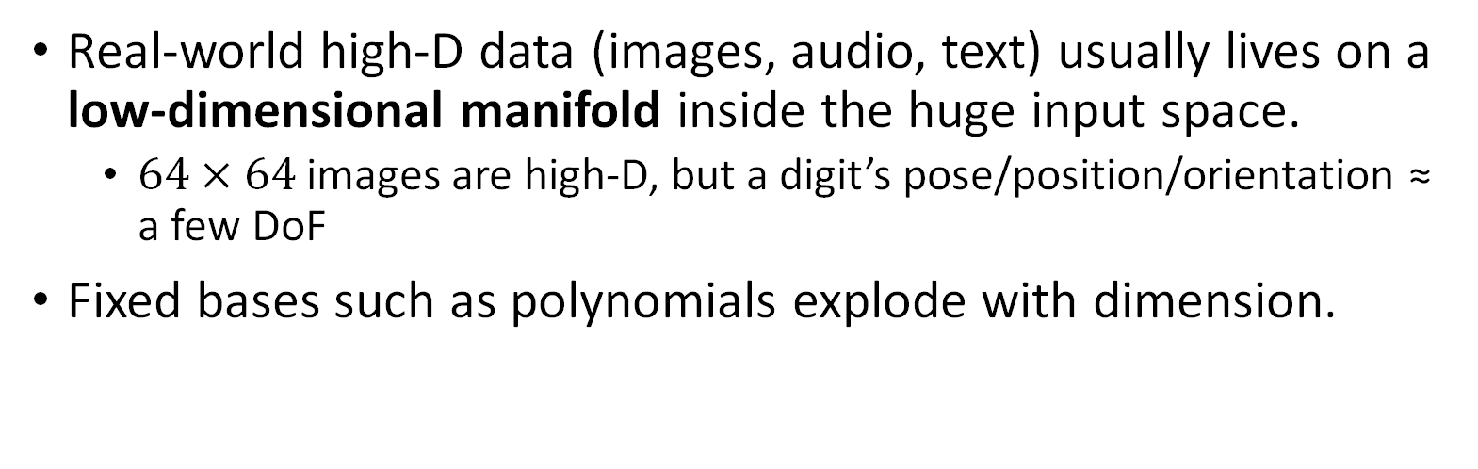
Data Manifolds
Real-world high-D data (images, audio, text) usually lives on a low-dimensional manifold inside the huge input space.
$64×64$ images are high-D, but a digit’s pose/position/orientation ≈ a few DoF
Fixed bases such as polynomials explode with dimension.
If we instead model along the manifold, complexity scales with manifold dimension (small), not data dimension (huge).

Slide 8

Data Manifolds $→$ Neural Networks
If we instead model along the manifold, complexity scales with manifold dimension (small), not data dimension (huge).
Neural networks = data-dependent bases
NNs learn basis functions from data that adapt to the manifold (vs. hand-crafted/fixed).
They also learn which directions on the manifold are relevant to the task.

Slide 9
Neural Network

Slide 10
Neuron

Slide 11
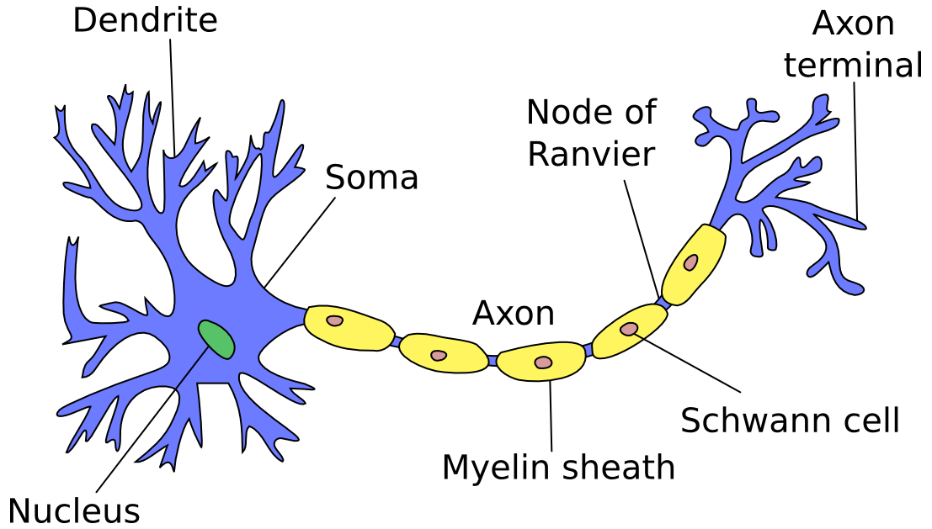
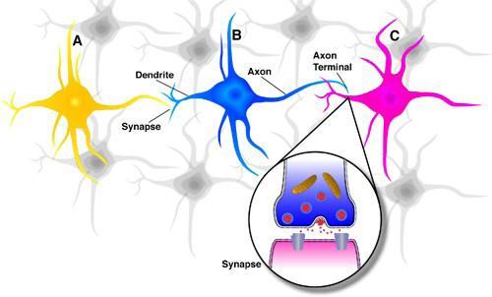
The Structure of a Biological Neuron
Simple building block: Neuron
Dendrite: Collecting signals from other neurons.
Soma (cell body): Spatial summation and processing.
Axon: Transmitting signals to dendrites of other cells.
Synapse: Neurons use synaptic connections to exchange information.
Synapses can be either excitatory or inhibitory in strength.
Notes:
Various structural parts exist and we discuss them bc these elements and their characteristics exist and are replicated in an artificial neuron.
Soma or cell body - axon, synapse, dendrites
Dendrites: connected to the cell body. they are tree-like structural networks made up of nerve fibers. They are connected to the soma or cell body
Axon: single like the connection extending from the cell body and carries information/signal from the neuron
Soma: the main structural part of the cell which carries the nucleus.
Synapse: interconnected neurons use these synaptic connections to exchange information

Slide 12
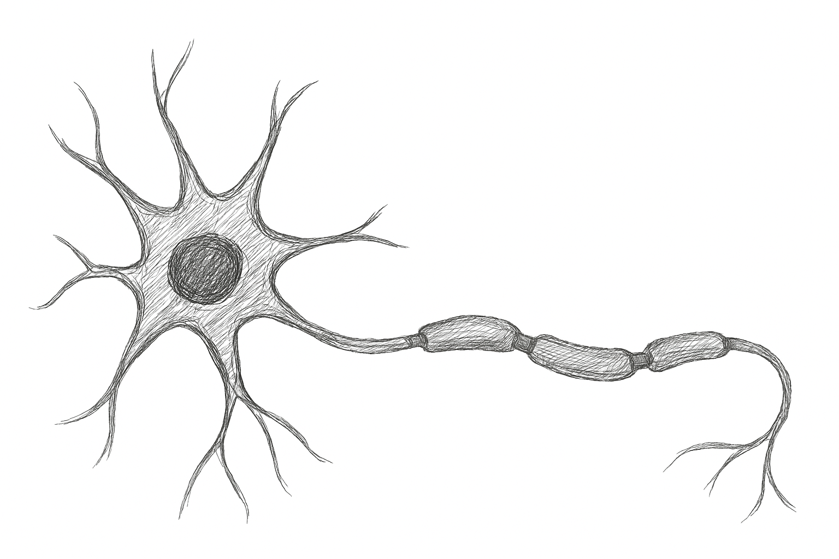
Starting with a Single Neuron
Simulate the firing of a neuron as a weighted combination of its inputs.
Inputs
Inputs
Outputs
Inputs

Slide 13
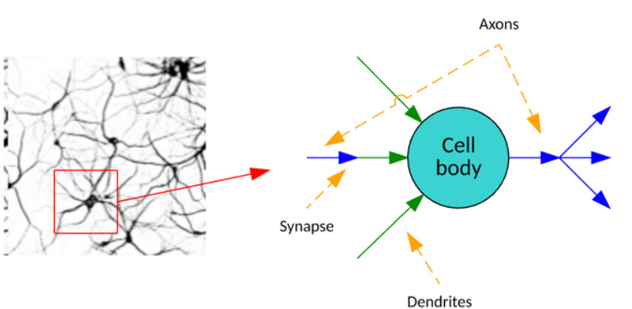










From Biological to Artificial Neurons
Biological neuron contains
Inputs
Summation of inputs
Processing unit
Output
$$1$$
$$w_{0}$$
$$x_{1}$$
Processing unit
Artificial neuron
$$w_{1}$$
$$x_{2}$$
$$w_{2}$$
+
$$y=f(w_{0}+w_{1}x_{1}+…+w_{D}x_{D})$$
$$⋮$$
$$x_{D}$$
$$w_{D}$$
Linear Combination of Inputs
Notes:
Artificial neuron is nothing but a mathematical function

Slide 14





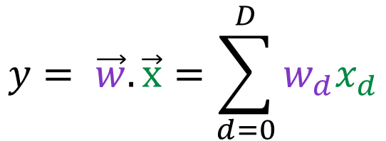
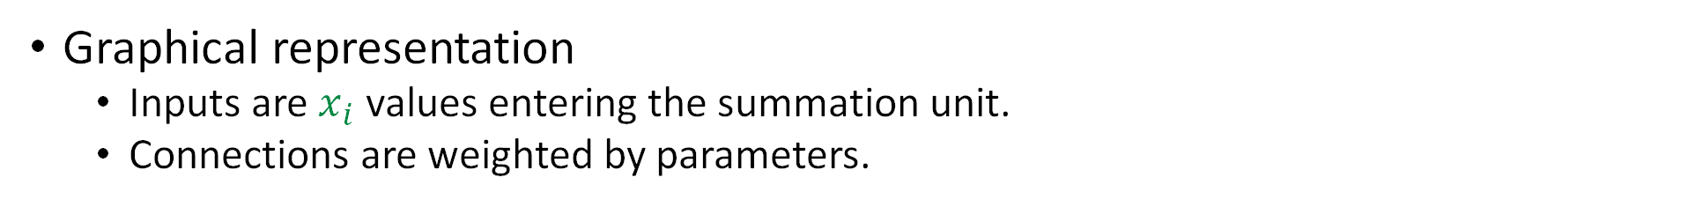


Linear Regression in a Summation Unit
Graphical representation
Inputs are $x_{i}$ values entering the summation unit.
Connections are weighted by parameters.
$$y= \vec{w}.\vec{x}=\sum_{d=0}^{D}{w_{d}x_{d}}$$
Bias Term
$$x_{1}$$
$$w_{1}$$
$$w_{0}$$
Linear Combination of Inputs
$$∑$$
$$y$$
Output
$$x_{D}$$
$$w_{D}$$
Weights

Slide 15
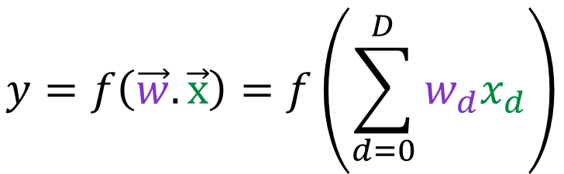

Neuron – Activation Function
An artificial neuron is a summation unit + an activation function.
The weighted summation is passed to the activation function to calculate the neuron's activation.
$$y=f\left(\vec{w}.\vec{x}\right)=f\left(\sum_{d=0}^{D}{w_{d}x_{d}}\right)$$
Bias Term
$$x_{1}$$
$$w_{1}$$
$$w_{0}$$
Linear Combination of Inputs
$$∑$$
$$y$$
Output
$$w_{D}$$
Activation
Function
$$x_{D}$$
Weights

Slide 16



A Simple Neuron
An artificial neuron is a summation unit + an activation function.
The weighted summation is passed to the activation function to calculate the neuron's activation.
$$y=f\left(\vec{w}.\vec{x}\right)=f\left(\sum_{d=0}^{D}{w_{d}x_{d}}\right)$$
Bias Term
1.2
3.7
-2.1
-0.6
$$w_{1}$$
$$w_{0}$$
Linear Combination of Inputs
$$w_{2}$$
$$∑$$
$$y$$
Output
$$w_{3}$$
$$w_{4}$$
Activation Function
Weights

Slide 17






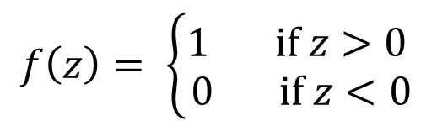






A Neuron with Step Function as Activation
Assume the activation function to be a step function.
If the weighted combination of inputs is negative, the output is 0 → neuron is not activated.
If the weighted combination of inputs is positive, the output is 1 → neuron is activated.
$$f\left(z\right)= \left\{\begin{aligned}1 if z>0 \\ 0 if z<0\end{aligned}\right.$$
$$z>0$$
$$z= \vec{w}.\vec{x}$$
$$x_{1}$$
$$w_{0}$$
$$x_{2}$$
$$w_{1}$$
$$∑$$
$$y$$
$$z<0$$
$$x_{1}$$
$$x_{D}$$
$$w_{D}$$

Slide 18



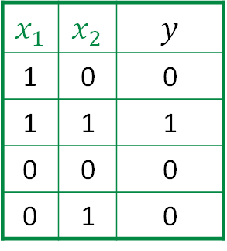






Functional Completeness - AND
$$x_{1}$$ | $$x_{2}$$ | $$y$$
1 | 0 | 0
1 | 1 | 1
0 | 0 | 0
0 | 1 | 0
$$x_{2}$$
1
1
$$x_{1}$$
$$x_{1}$$
$$w_{1}$$
$$w_{0}$$
$$∑$$
$$y$$
$$x_{2}$$
$$w_{2}$$

Slide 19

Do not edit How to change the design
What are example parameters for the AND gate? w_0=?, w_1=?, w_2=?
The Slido app must be installed on every computer you’re presenting from

Slide 20
Functional Completeness - AND
$$x_{1}$$ | $$x_{2}$$ | $$y$$
1 | 0 | 0
1 | 1 | 1
0 | 0 | 0
0 | 1 | 0
$$x_{2}$$
1
1
$$x_{1}$$
$$x_{1}$$
$$w_{1}$$
$$w_{0}$$
$$∑$$
$$y$$
$$x_{2}$$
$$w_{2}$$

Slide 21
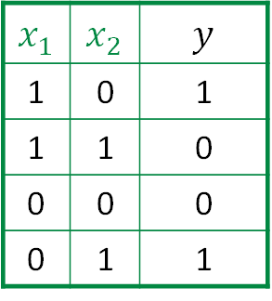
Functional Completeness - XOR
$$x_{1}$$ | $$x_{2}$$ | $$y$$
1 | 0 | 1
1 | 1 | 0
0 | 0 | 0
0 | 1 | 1
$$x_{2}$$
1
1
$$x_{1}$$
$$x_{1}$$
$$w_{1}$$
$$w_{0}$$
$$∑$$
$$y$$
$$x_{2}$$
$$w_{2}$$

Slide 22

Do not edit How to change the design
Can we build the XOR gate with only one neuron?
The Slido app must be installed on every computer you’re presenting from

Slide 23



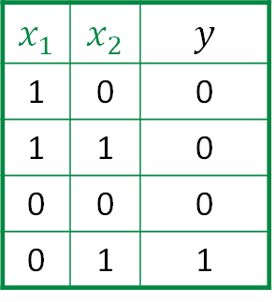
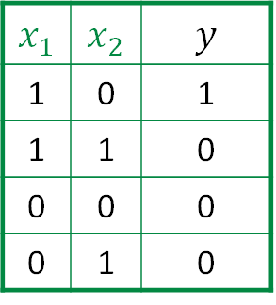


Functional Completeness - XOR
$$x_{2}$$
Non-linear Decision Boundary
(No linear separability)
$$x_{1}$$ | $$x_{2}$$ | $$y$$
1 | 0 | 1
1 | 1 | 0
0 | 0 | 0
0 | 1 | 1
1
$$x_{1}AND {\sim x}_{2}$$
$$x_{1}$$ | $$x_{2}$$ | $$y$$
1 | 0 | 1
1 | 1 | 0
0 | 0 | 0
0 | 1 | 0
$$x_{2}$$
1
$$x_{1}$$
1
$$x_{1}XOR x_{2}$$
$$x_{2}$$
1
$$x_{1}$$
1
$${\sim x}_{1}AND x_{2}$$
OR
$$x_{1}$$ | $$x_{2}$$ | $$y$$
1 | 0 | 0
1 | 1 | 0
0 | 0 | 0
0 | 1 | 1
$$x_{2}$$
1
$$x_{1}$$
1
1
$$x_{1}$$

Slide 24
Neural Network

Slide 25
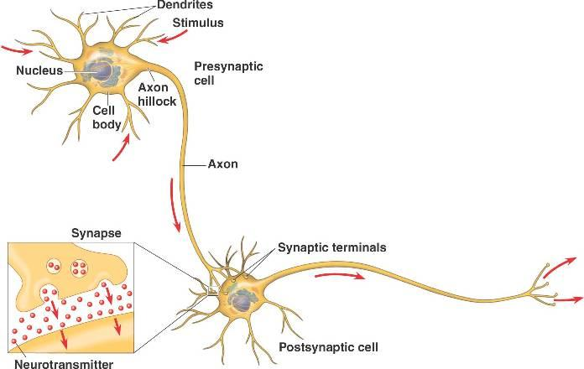




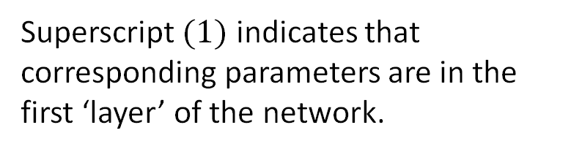



Neural Network
Input layer
$$w_{10}^{(1)}$$
Neuron 1
$$x_{0}$$
$$w_{11}^{(1)}$$
$$σ\left(\vec{w}.\vec{x}\right)$$
$$x_{1}$$
$$w_{1D}^{(1)}$$
$$x_{D}$$
Superscript $(1)$ indicates that corresponding parameters are in the first ‘layer’ of the network.

Slide 26

Neural Network
Input layer
$$w_{10}^{(1)}$$
Neuron 1
$$x_{0}$$
$$w_{11}^{(1)}$$
$$z_{1}$$
$$x_{1}$$
$$w_{1D}^{(1)}$$
$$x_{D}$$
Superscript $(1)$ indicates that corresponding parameters are in the first ‘layer’ of the network.

Slide 27






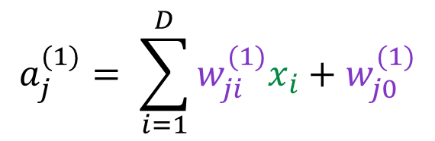


Neural Network
Input layer
Hidden layer
Activations ($M$ linear combination of inputs)
$$w_{10}^{(1)}$$
$$x_{0}$$
$$z_{1}$$
$$a_{j}^{(1)}= \sum_{i=1}^{D}{w_{ji}^{(1)}x_{i}}+w_{j0}^{(1)}$$
Bias Term
$$j∈\{1, …, M\}$$
$$x_{1}$$
$$z_{2}$$
Pre-activation or logits
Weights
$$w_{1D}^{(1)}$$
$$x_{D}$$
$$w_{2D}^{(1)}$$
$$z_{j}^{(1)}=h(a_{j}^{(1)})$$
$$j∈\{1, …, M\}$$
$$z_{M}$$
$$w_{MD}^{(1)}$$
Output of basis functions
Activation Function
Superscript $(1)$ indicates that corresponding parameters are in the first ‘layer’ of the network.

Slide 28



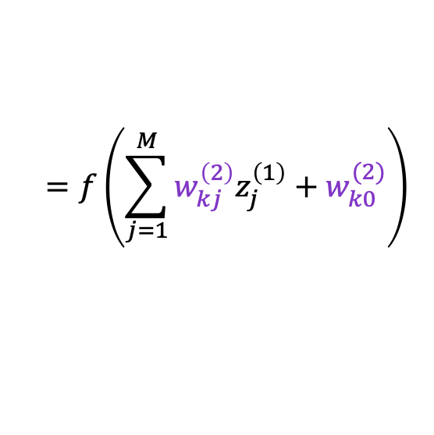




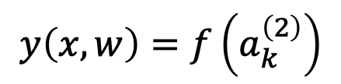








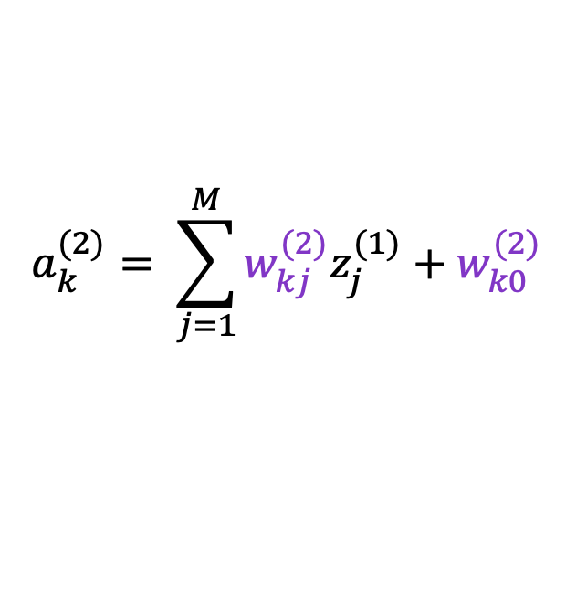
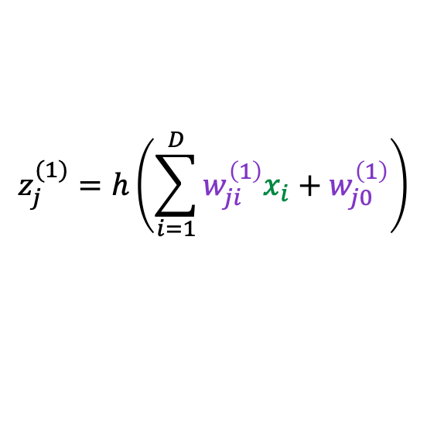





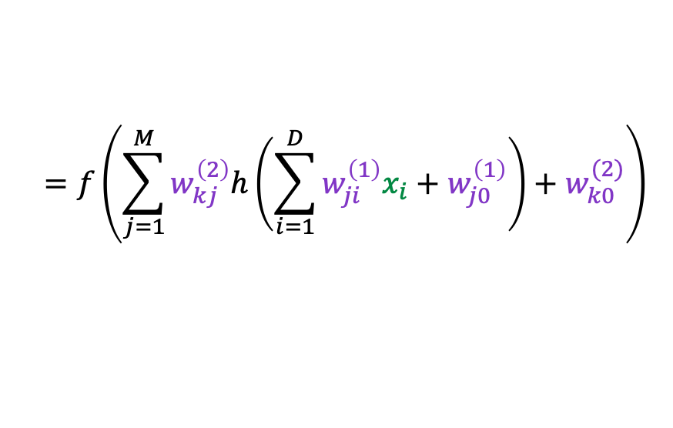

Hidden layer
$$z_{0}$$
Input layer
Output layer
$$w_{10}^{(1)}$$
$$w_{10}^{(2)}$$
$$x_{0}$$
$$a_{k}^{(2)}= \sum_{j=1}^{M}{w_{kj}^{(2)}z_{j}^{(1)}}+w_{k0}^{(2)}$$
$$z_{1}$$
$$w_{11}^{(2)}$$
$$k∈\{1, …, K\}$$
$$x_{1}$$
$$w_{K1}^{(2)}$$
$$y_{1}$$
$$y\left(x, w\right)=f\left(a_{k}^{\left(2\right)}\right)$$
$$z_{2}$$
$$=f\left(\sum_{j=1}^{M}{w_{kj}^{\left(2\right)}z_{j}^{\left(1\right)}}+w_{k0}^{(2)}\right)$$
$$w_{1D}^{(1)}$$
$$x_{D}$$
$$w_{2D}^{(1)}$$
$$y_{K}$$
$$w_{1M}^{(2)}$$
$$=f\left(\sum_{j=1}^{M}{w_{kj}^{\left(2\right)}h\left(\sum_{i=1}^{D}{w_{ji}^{\left(1\right)}x_{i}}+w_{j0}^{\left(1\right)}\right)}+w_{k0}^{(2)}\right)$$
$$z_{M}$$
$$w_{MD}^{(1)}$$
$$w_{KM}^{(2)}$$
$$z_{j}^{(1)}=h\left(\sum_{i=1}^{D}{w_{ji}^{\left(1\right)}x_{i}}+w_{j0}^{\left(1\right)}\right)$$
Now, let's add output layer.
$$=f\left(W^{\left(2\right)}h\left(W^{\left(1\right)}x\right)\right)$$
$$j∈\{1, …, M\}$$
What about the intercept?

Slide 29




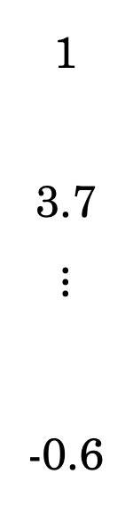















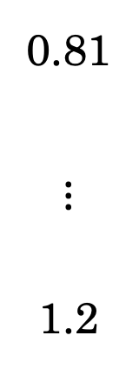
Neural Network
Hidden layer
Input layer
$$z_{0}$$
1
3.7
$$⋮$$
-0.6
$$w_{10}^{(1)}$$
$$w_{10}^{(2)}$$
Output layer
$$x_{0}$$
$$z_{1}$$
$$w_{11}^{(2)}$$
$$x_{1}$$
$$w_{k1}^{(2)}$$
$$y_{1}$$
0.81
$$⋮$$
1.2
$$z_{2}$$
$$w_{1D}^{(1)}$$
$$x_{D}$$
$$w_{2D}^{(1)}$$
$$y_{K}$$
$$w_{1M}^{(2)}$$
$$z_{M}$$
$$w_{MD}^{(1)}$$
$$f$$
$$w_{kM}^{(2)}$$

Slide 30

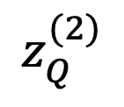









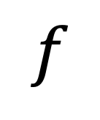


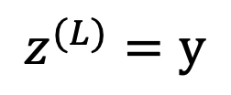
















Deep Neural Network
$$l∈\{1, …, L\}$$
Hidden layer 1
Hidden layer 3
Hidden layer 2
Input layer
$$z_{0}^{(1)}$$
$$z^{(l)}=h^{\left(l\right)}\left(W^{(l)}z^{(l−1)}\right)$$
$$w_{10}^{(2)}$$
Output layer
$$w_{10}^{(1)}$$
$$z_{0}^{(2)}$$
$$z_{0}^{(3)}$$
$$x_{0}$$
$$w_{10}^{(3)}$$
$$z_{1}^{(1)}$$
$$w_{11}^{(2)}$$
$$w_{10}^{(4)}$$
Activation in layer $l$
Weights in layer $l$
$$x_{1}$$
$$z_{1}^{(2)}$$
$$z_{1}^{(3)}$$
$$y_{1}$$
$$z_{2}^{(1)}$$
$$z^{(0)}=x$$
$$w_{1D}^{(1)}$$
$$w_{P1}^{(3)}$$
$$w_{1M}^{(2)}$$
$$z^{(L)}=y$$
$$z_{P}^{(2)}$$
$$z_{Q}^{(2)}$$
$$y_{K}$$
$$x_{D}$$
$$w_{2D}^{(1)}$$
$$z_{M}^{(1)}$$
$$w_{KQ}^{(4)}$$
$$w_{QP}^{(3)}$$
$$f$$
$$w_{MD}^{(1)}$$
$$w_{PM}^{(2)}$$

Slide 31
Universal Approximation

Slide 32
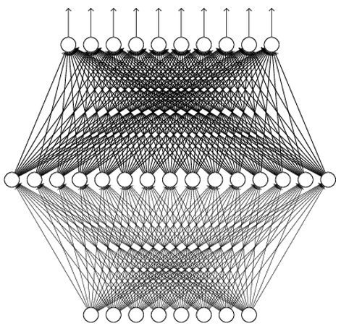
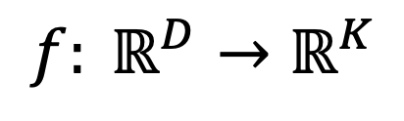
Universality Theorem
$$f: ℝ^{D}→ℝ^{K}$$
Can be realized by a network with one hidden layer
(given enough hidden neurons)
Visual proof: http://neuralnetworksanddeeplearning.com/chap4.html
Neural networks are said to be universal approximators.
Why “Deep” neural network not “Fat” neural network?

Slide 33
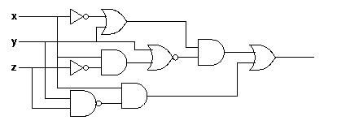
Why Deep? Analogy
Logic circuits
Neural network
Logic circuits consists of gates.
Two layers of logic gates can represent any Boolean function.
Using multiple layers of logic gates to build some functions are much simpler.
Neural network consists of neurons.
A hidden layer network can represent any continuous function.
Using multiple layers of neurons to represent some functions are much simpler.
less gates needed
less parameters
less data?

Slide 34
Activation Functions

Slide 35
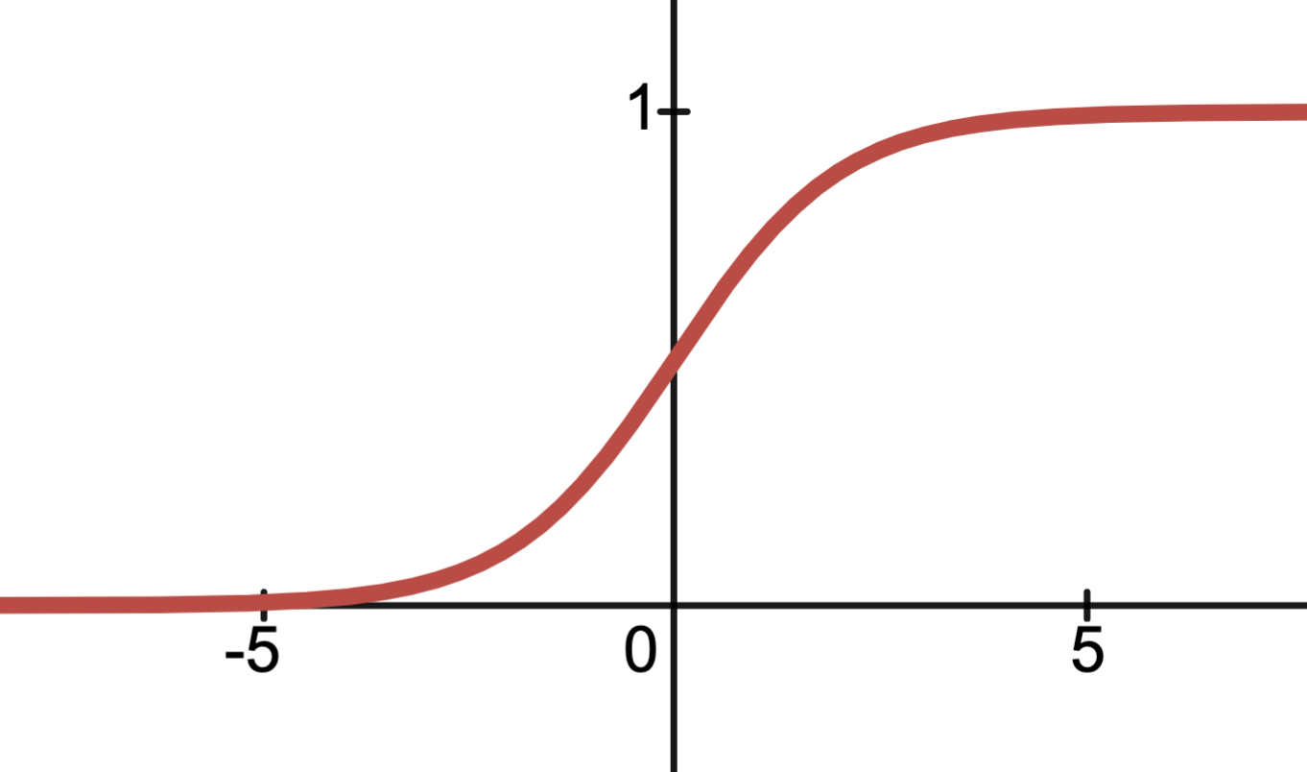
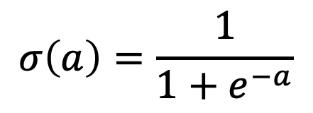


Activation Functions
The simplest option for a hidden unit activation function is the identity function.
But it is redundant to have a hidden layer if all activations are identity.
Simple non-linear differentiable activation function is sigmoid.
$$σ\left(a\right)$$
$$σ\left(a\right)=\frac{1}{1+e^{−a}}$$
$$a$$

Slide 36
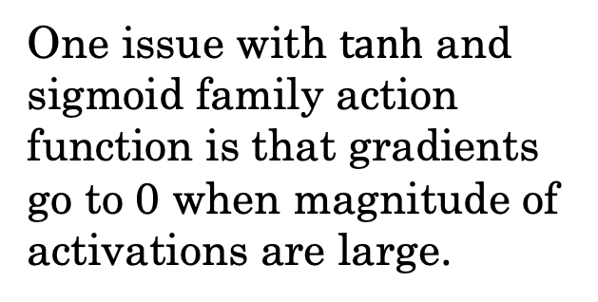
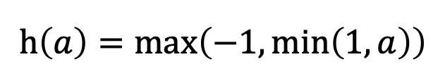

Other Activation Functions
One issue with $tanh$ and sigmoid family action function is that gradients go to 0 when magnitude of activations are large.
We need an activation that has non-zero gradient at least when activations are large positive values.
$$\tanh\left(a\right)=2σ\left(2a\right)−1$$
$=\frac{e^{a} −e^{−a}}{e^{a}+e^{−a}}$
$$h\left(a\right)=\max\left(−1,\min\left(1, a\right)\right)$$

Slide 37




Other Activation Functions
$$h(a)=\ln\left(1+\exp\left(a\right)\right)$$
$$h(a)=\max\left(0, a\right)$$
$$h\left(a\right)=\max\left(0, a\right)+α\min\left(0, a\right)$$
Neurons with negative activations will receive "no error signal"
When $a≫1$, $h\left(a\right)≃a$
Also called soft ReLU

Slide 38
Building And Training Neural Networks in PyTorch

Slide 39

The most widely used framework for building and training deep neural networks.
Related frameworks: TensorFlow, JaX, …
Important features:
Automatic differentiation (focus of Thursday’s lecture)
Intuitive support for hardware accelerators
Easy to use APIs for state-of-the-art model architectures
Leaning on your own:
Basics: https://docs.pytorch.org/tutorials/beginner/basics
Tutorials: https://docs.pytorch.org/tutorials/

Slide 40
Big Concepts in PyTorch
torch.tensor is the basic datatype used to encode data, weights, and activations and is very similar numpy.ndarrays.
Neural networks are built using the many primitives in the torch.nn module and defining the forward process of making a prediction.
PyTorch uses automatic differentiation to efficiently compute the gradient.
Training is accomplished by (you) implementing some variation of gradient descent.

Slide 41
torch.tensor
The basic building block of PyTorch is the torch.tensor which is very similar to the numpy.ndarray.
Construction: torch.tensor([[1.0], [2.0]]); torch.ones(2,3)
Indexing and slicing: x[:, 3]
Shape and type: x.shape; x.dtype
Operations: torch.mean(x, axis=1); a.T @ x
Key differences:
Device Placement: x.to(“cuda”); x.to(“cpu”)
Tensors (can) track how they were computed to enable automatic differentiation: x.grad_fn

Slide 42
torch.nn.functional and torch.nn
The torch.nn.functional Python module All contains all the basic stateless neural network functions (e.g., relu).
The torch.nn Python module contains the basic building blocks of neural networks.
nn.Module is the base class which all models and layers extend.
__init__: defines all the model parameters.
forward (__call__): defines the model/layer logic
nn.Parameters is used to define model parameters (in __init__)
Used to wrap parameter tensors so they can be automatically tracked
There are hundreds of layer modules: nn.Linear; nn.Softmax; ...

Slide 43
torch.nn.Module
When building a new model you extend the nn.Module
class MLPModel(nn.Module):
def __init__(self, dims, activation="relu"):
super().__init__()
self.layers = nn.ModuleList(
[nn.Linear(dims[i], dims[i+1]) for i in range(len(dims)-1)])
if activation == "relu": self.act = nn.functional.relu
elif: self.act = torch.tanh
def forward(self, x):
for i, layer in enumerate(self.layers):
x = layer(x)
if i < len(self.layers)-1:
x = self.act(x)
return x
Extend nn.Module
Add modules to your module. These add parameters.
Compute the forward pass using the layer modules.

Slide 44
Computing Gradients using Autograd
PyTorch uses automatic differentiation to automatically (and efficiently) compute the gradient of the loss with respect to all parameters.
Reset the Gradient
(needed for iteration)
model.zero_grad()
pred = model(x)
loss = loss_fn(pred, t)
loss.backward()
print(model.linear.weight.grad)
Compute the loss
Compute the gradient of the loss
Gradients are attached to each parameter

Slide 45
Implement Gradient Descent with Optimizer
In PyTorch you implement your own gradient descent loop but you can use built in update rules (e.g., Adam) called optimizers.
Minibatch SGD DataLoader
loader = DataLoader(tr_data, batch_size=32, shuffle=True)
optimizer = torch.optim.Adam(model.parameters(),eta)
for epoch in range(nepochs):
for (x, t) in loader:
optimizer.zero_grad()
loss = loss_fn(model(x), t)
loss.backward()
optimizer.step()
Adam optimizer
Epoch is one pass over data
Load one minibatch at a time
Compute the gradient of the loss
Use optimizer to update all the parameters (1-step)

Slide 46




Demo

Slide 47
Neural Networks and PyTorch
Lecture 14
Credit: Joseph E. Gonzalez and Narges Norouzi
Reference Book Chapters: Chapter 6 up to section 6.3.1

